Slide 1

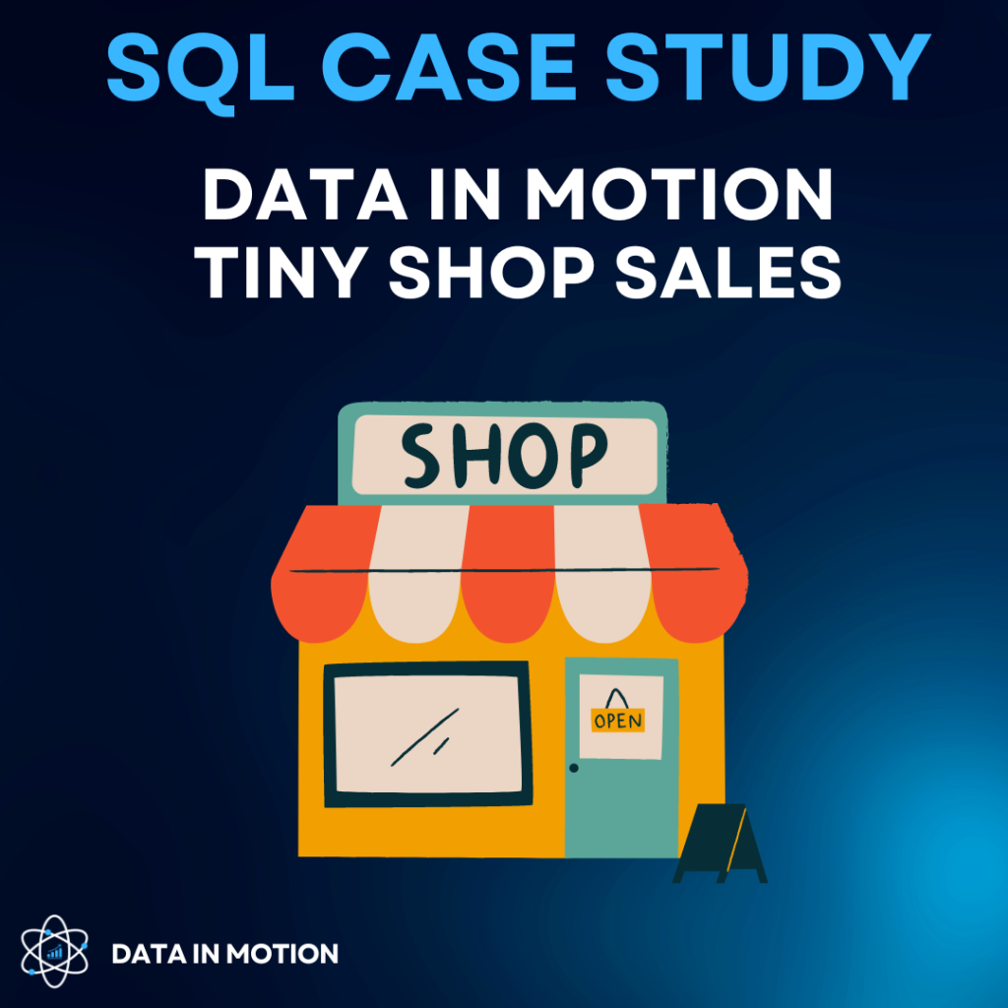
By Precious Raman
INTRODUCTION
This is a Data in Motion case study aimed at querying the Tiny Shop Sales Database to gain valuable insights.

Slide 2

DESCRIPTION
The Tiny Shop Sales Database consists of 4 tables:
Customers – has all customer details’
Products – has all product and price details.
Orders - contains all orders including order date .
Order items – has all order quantity recorded.

Slide 3
CASE OVERVIEW
PostgreSQL was employed in the querying of this database.
This case study covers simple and advanced SQL concepts like:
Basic Aggregation
CASE WHEN statements
Windows Functions
Joins
Date Time Functions
CTEs

Slide 4
CASE QUESTIONS
Which product has the highest price? Only return a single row.
Which customer has made the most orders?
What’s the total revenue per product?
Find the day with the highest revenue.
Find the first order (by date) for each customer.
Find the top 3 customers who have ordered the most distinct products
Which product has been bought the least in terms of quantity?
What is the median order total?
For each order, determine if it was ‘Expensive’ (total over 300), ‘Affordable’ (total over 100), or ‘Cheap’.
Find customers who have ordered the product with the highest price.

Slide 5
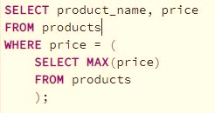
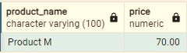
1. Which product has the highest price? Only return a single row.
This query retrieves the product names and their corresponding prices from the "products" table using the SELECT statement WHERE the price matches the highest price found within the same table. This involves using a subquery to determine the maximum price value present in the "products" table.

Slide 6
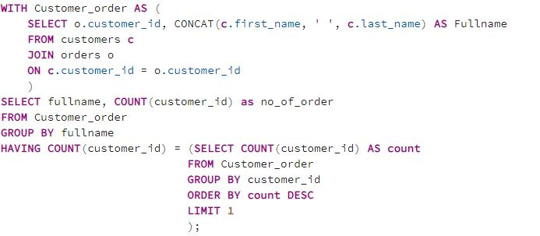
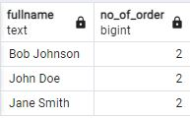
2. Which customer has made the most orders?
This SQL query creates a common table expression (CTE), which JOINS data from the "customers" and "orders" tables.
The main query then SELECTs the full names and COUNTs the occurrences of customer IDs, grouping the results by full names. Then, the "HAVING" clause filters the results by including only those full names that have a customer ID count equal to the maximum count of customer IDs across all customers according to the SUBQUERY.

Slide 7
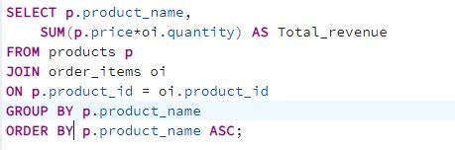
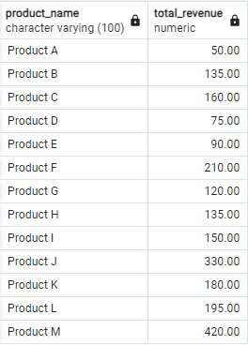
3. What’s the total revenue per product?
This SQL query combines data from "products" and "order_items" tables using JOIN , SELECTs product name and calculates the total revenue for product by multiplying price with the quantity ordered.
The results are grouped and sorted by the product name.

Slide 8
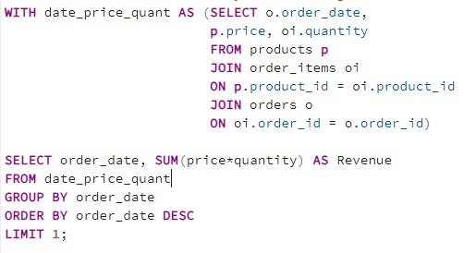
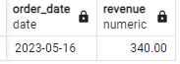
4. Find the day with the highest revenue.
This query uses a common table expression (CTE) to merge data from "products," "order_items," and "orders" tables, SELECTING order dates, product prices, and quantities.
The main query then calculates revenue for each order date by multiplying prices and quantities, GROUP BY and ORDER BY date in descending order, and finally LIMITS result to produce the date with the highest revenue.

Slide 9
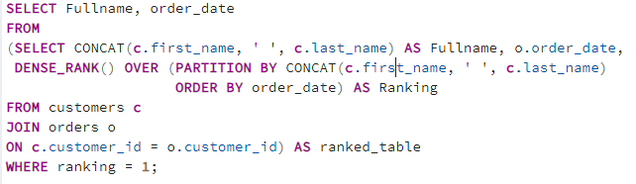
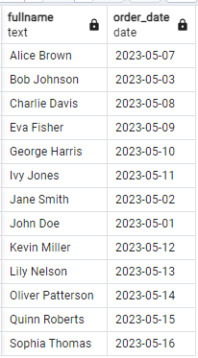
5. Find the first order (by date) for each customer.
This query retrieves the names of customers and their first order dates by creating a ranked table using a common table expression (CTE) that JOINS data from the "customers" and "orders" tables. The DENSE_RANK() function assigns a ranking based on the order dates for each unique customer name.
The final output displays the names and first order dates of customers who were ranked first in terms of their earliest order date.

Slide 10
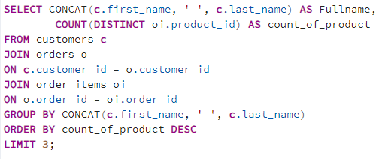
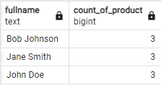
6. Find the top 3 customers who have ordered the most distinct products
This query SELECTS customer names and the count of unique products they have ordered by JOINING data from the "customers," "orders," and "order_items" tables. The result is GROUPED BY customer names, SORTED BY the descending order of product count, and LIMITED to the top three customers with the highest product counts.

Slide 11
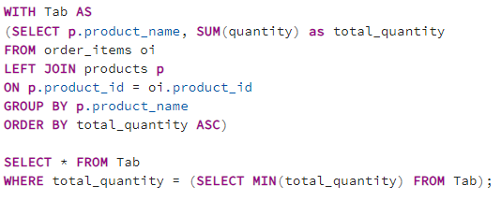
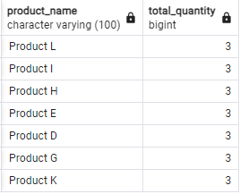
7. Which product has been bought the least in terms of quantity?
This query SELECTS product name and the total quantity of products ordered for each product by JOINING data from the "order_items" and "products" tables by creating a CTE named "Tab.
The main query selects and displays rows from "Tab" where the total quantity is equal to the minimum total quantity, effectively showing the product(s) with the lowest order quantity.

Slide 12
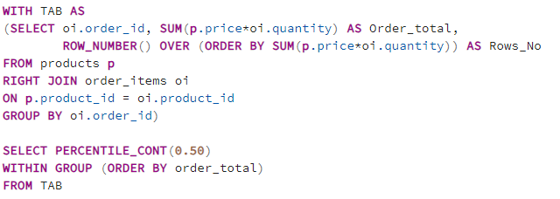
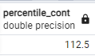
8. What is the median order total?
This query calculates order totals by multiplying product price with quantity, then assigns row numbers based on these totals.
The final step calculates and returns the median order total using the PERCENTILE_CONT function, providing insight into the middle order value distribution.

Slide 13
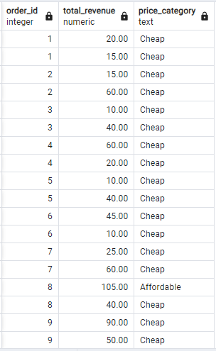
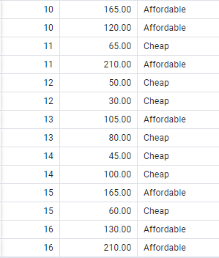
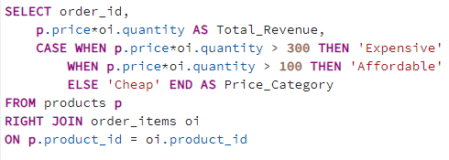
9. For each order, determine if it was ‘Expensive’ (total over 300), ‘Affordable’ (total over 100), or ‘Cheap’.
This query JOINS data from "products" and "order_items" tables to calculate total revenue for each order item. It also categorizes each order item based on its revenue into "Expensive," "Affordable," or "Cheap."

Slide 14
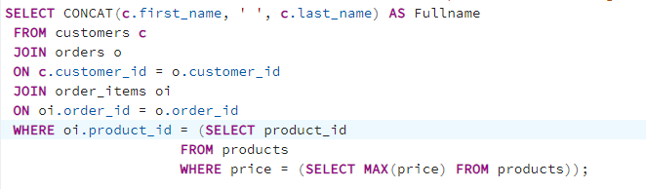
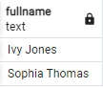
10. Find customers who have ordered the product with the highest price.
This query retrieves the full name of customers who have placed orders containing the most expensive product by joining data from the "customers," "orders," and "order_items" tables, and filtering order items that match the product with the highest price in the "products" table.

Slide 15

THANK YOU

